Slide 1
Matplotlib Assignment
Amaie Gebregzabheir

Slide 2
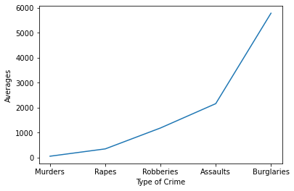
Averages of each Crime
This graph is showing a steady upward curve in the type of crimes committed in Denver from 2001 to 2013. Over those 13 years we can see that burglaries had the highest average out of all the crimes which could also be linked to some of the other crimes on the list giving it a higher number.

Slide 3
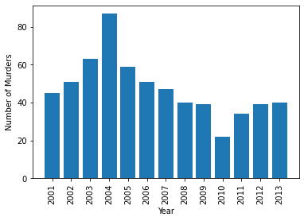
Murders over 13 years
Here we can see the number of murders of each year for 13 years. 2004 showed an odd spike in murders but following that the years showed a decrease in murders until hitting the lowest amount in 2010.

Slide 4
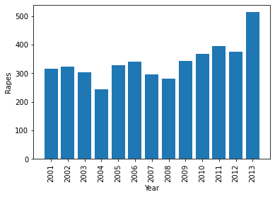
Rapes over 13 Years
This graph has the number of rapes for every year in 13 years in Denver. It had shown a steady average over most of the years until the dramatic increase in 2013. This makes you curious to see if from 2014 to now the number of rapes stayed at that new peak or decreased over time like murders.

Slide 5
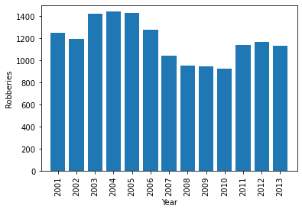
Robberies over 13 years
This final graph shows the robberies throughout the 13 years and unfortunately shows a very high number throughout the whole thing. It can also show that due to this being so high did the previous crimes shown connect with this. Could some of the robberies led to murder or rape.

Slide 6
Conclusion
After analyzing the data, we see that burglaries had the highest average within Denver and considering sometimes other crimes can be connected there is a possibility some of these crimes started as a burglary and may have led to another one of the crimes.
If we were to see the other graphs of the other crimes, there could be similarities in increases of crimes over certain years.
Questions that arise from looking at some of the visuals could consist of why murders had a sudden uptick in 2004 but following that went back down.
There could be stricter rules or laws implemented in Denver around that time.

